Slide 1

NGUYỄN CẢNH HUY-20120496 THÁI NGUYỄN VIỆT HÙNG-20120488 VŨ HOÀNG-20120484 LÊ NGUYÊN DUY-20120461 PHAN XUÂN HOÀI-20120481
ĐỒ ÁN HỌC KÌ 1
2020-2021
GAME CÁ CƯỢC ĐUA XE
MÔN: NHẬP MÔN CÔNG NGHỆ THÔNG TIN
LỚP: 20CTT3C
NHÓM: 6
GIÁO VIÊN HƯỚNG DẪN:ThS. Võ Hoàng Quân

Slide 2
NỘI DUNG
1/GIAO DIỆN TRÒ CHƠI
2/CÁC CHỨC NĂNG CỦA TRÒ CHƠI
3/TÀI LIỆU THAM KHẢO

Slide 3
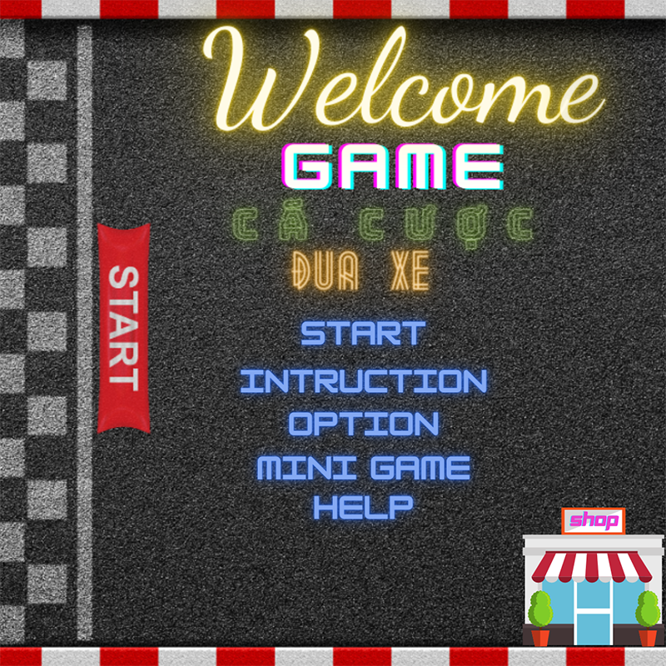
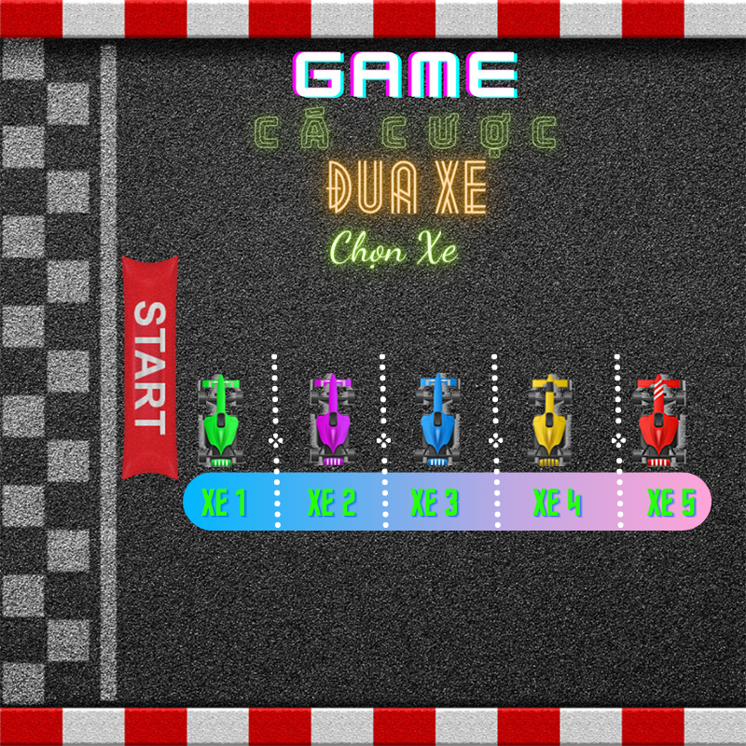
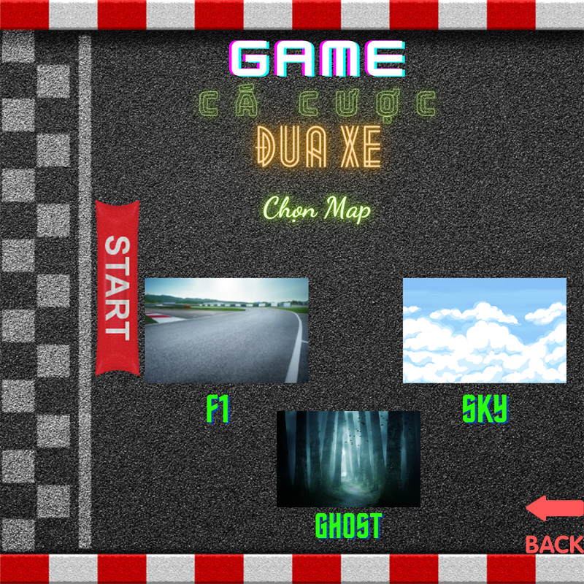
1/Giao diện trò chơi

Slide 4
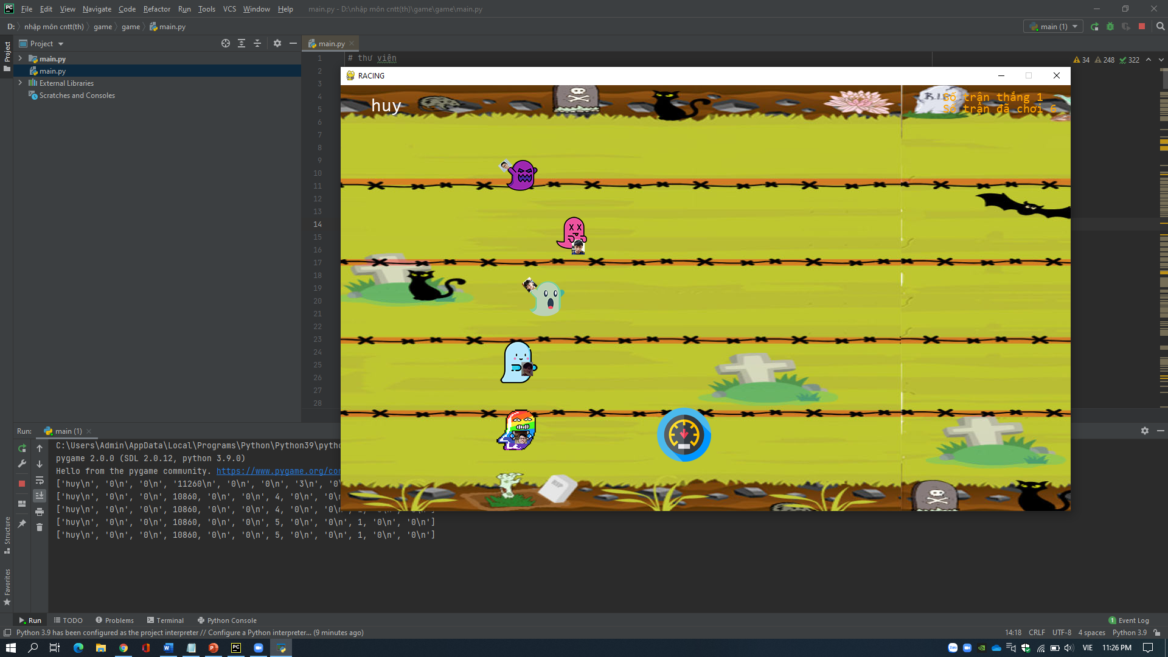
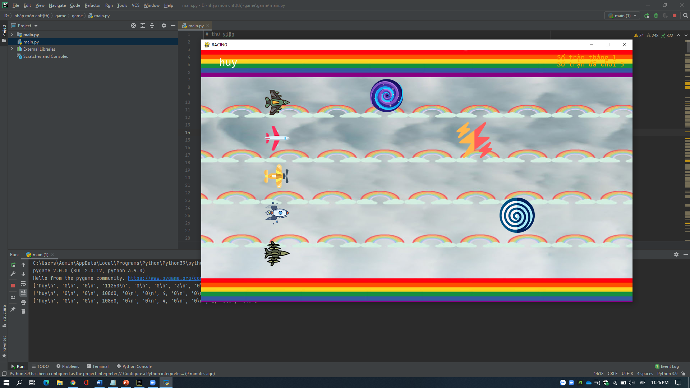
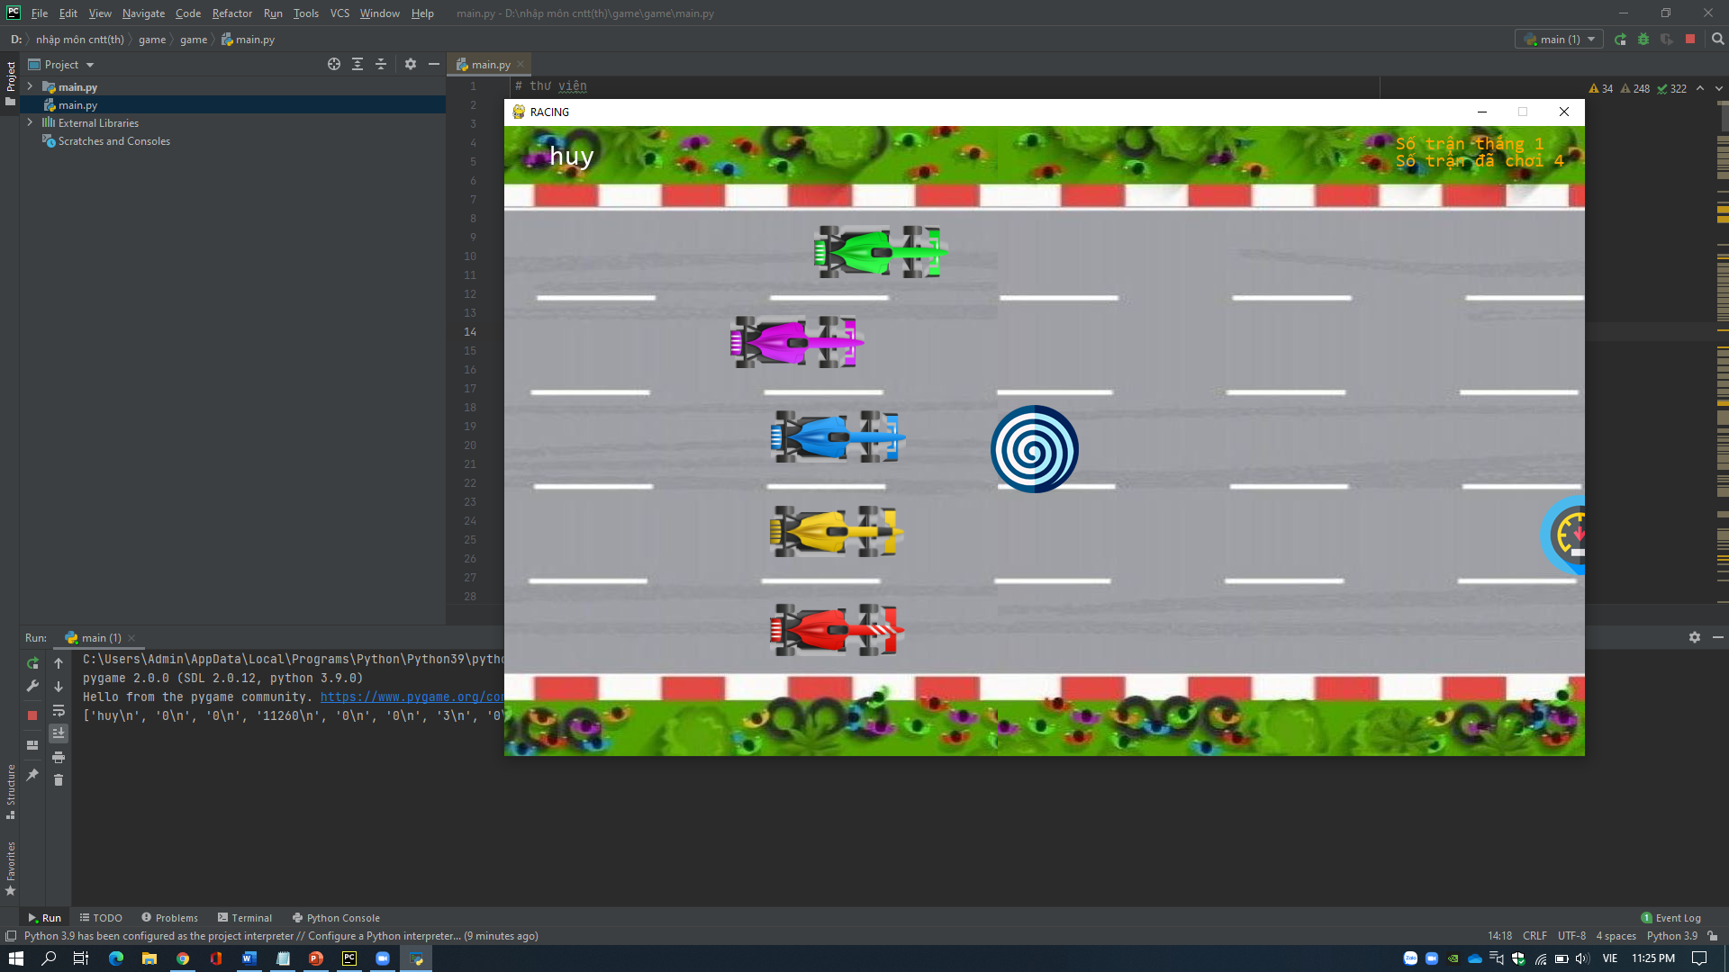
Newgame

Slide 5
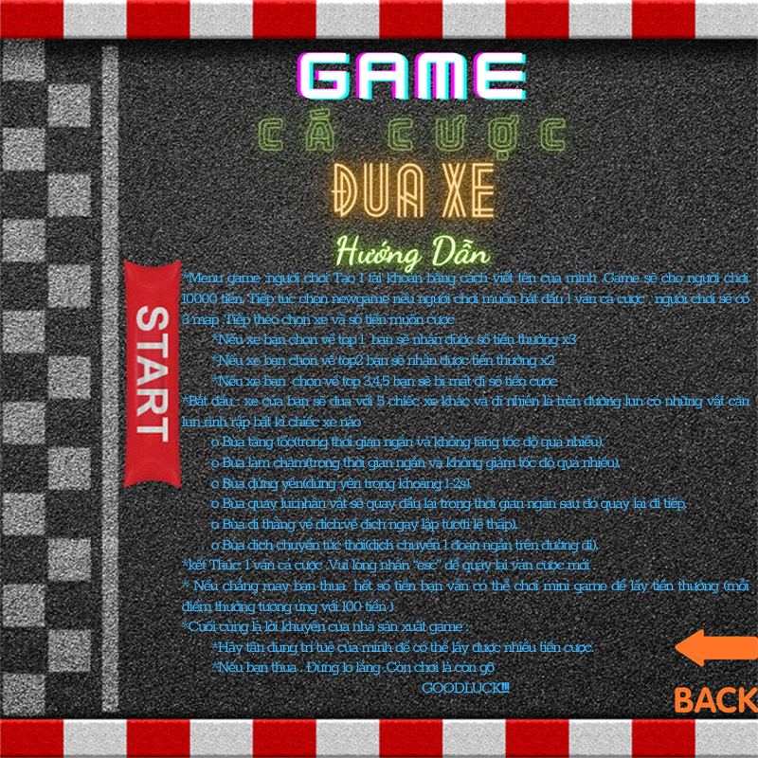
Intruction

Slide 6
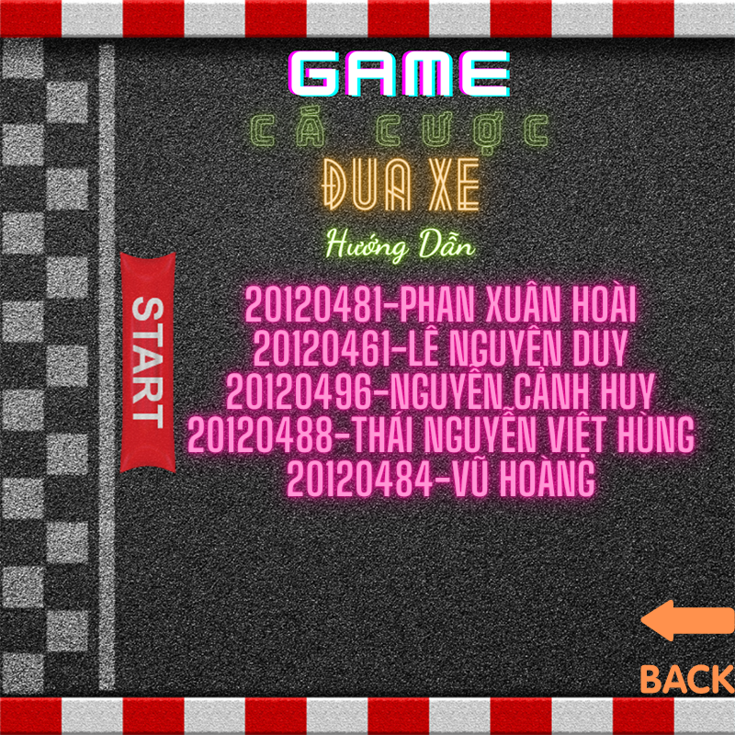
Thông tin nhóm

Slide 7
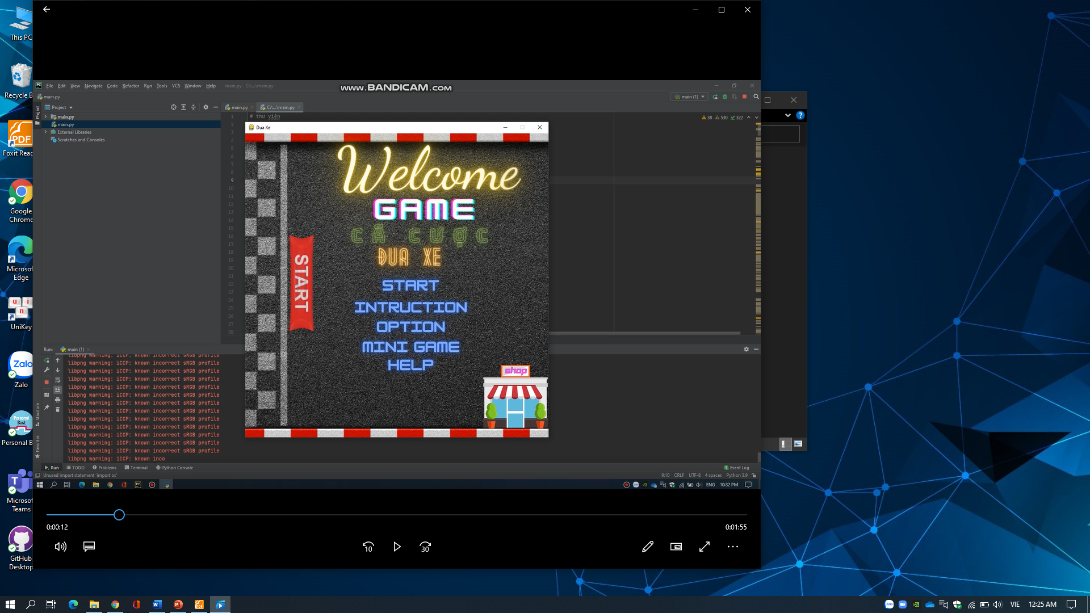
VIDEO DEMO GAME https://drive.google.com/drive/folders/1rjNIFtwMEXjyFeKUuzFN5e95a939gryp?usp=sharing

Slide 8
TÀI LIỆU THAM KHẢO
[1]https://www.howkteam.vn/?fbclid=IwAR0TGtNKf2xoXzce5GiAoN7GY_EVlH8Rc0_15k0DdyLLncP_t171eZgVSpk (20/12/2020)
[2]https://codelearn.io/?fbclid=IwAR1a63SYZPBrnNYELF9rTjqxWtVWykFczfsswhNlrZjvOI_kYv0-aBQxahs (22/12/2020)
[3]https://www.youtube.com/watch?v=2x2IPi8UkFM&fbclid=IwAR1GoLEH_A66kJH82uT2vzpVMMNzCIvTd7fuX_h0NUWHN9Tk2y-32fXRMIE (24/12/2020)
[4]https://www.youtube.com/watch?v=a5JWrd7Y_14&fbclid=IwAR2XulmkX0NWa9_DrEouoFsJYZU3oxsb9A-AjU0i9hkLehg75Ry65PnIHGk (25/12/2020)
[5]https://www.pygame.org/docs/ref/color.html?fbclid=IwAR0vsuKC7yj8IW4NNnT0ZCU0A-YfbZZyrJMtwxHCwZJSHbB5yQ3KxugQj5c (27/12/2020)
[6]https://www.pygame.org/docs/ref/display.html?fbclid=IwAR1TrBiPYeJFhAoG9jrYQ8tzMtCB_4fVyrLW54fDvH0GXh_BI4_dqOg-Gvo (30/12/2020)
[7]https://www.pygame.org/docs/ref/event.html?fbclid=IwAR0KmjCpdD3enKkyG_jUWBkDWCqwT9bxGw_GWNxMYB-rFjCgmIYtqsOMRSY (31/12/2020)
[8]https://codelearn.io/sharing/lap-trinh-game-flappybird-voi-python?fbclid=IwAR0vsuKC7yj8IW4NNnT0ZCU0A-YfbZZyrJMtwxHCwZJSHbB5yQ3KxugQj5c(1/1/2021)
[9]https://www.pygame.org/docs/ref/music.html?fbclid=IwAR0_HcNFRopv817JskFFluz3A67TN89Hb5VTOV908vstb8UstVN3fo7C7mM (2/1/2021)
[10]https://www.flaticon.com/?fbclid=IwAR3fpvFna4kmTK5TVD4IYj1-bAQJnaVmk1UPpPxuiWE03_4TxVpTtu9tIyg(30/12/2020)
[11]https://www.canva.com/?fbclid=IwAR39kQrG7bnGBKPUwTwXJZIDyuHuMHxaY2Psin5PKJH30lqQGWUPdnblZfk(26/12/2020)

Slide 9


